Slide 1
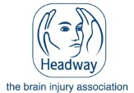
‘Reablement is everybody’s business’
Hampshire Neurological Alliance Study Day
in collaboration with Hampshire County Council
Anne Meader
Chair; Hampshire Neurological Alliance
Secretary; Carers Together
Service User & Carer

Slide 2
Housekeeping
Fire Alarm
Toilets
Smoking
Phones
Refreshments
Notes:
[PRESENTATION]
Go through H&S requirements.
2

Slide 3
Your local Headway
Deborah Robinson, Service Manager, Headway Portsmouth
Heather Jury, Service Manager, Headway Basingstoke

Slide 4
Who are we?
Every Headway is individual and local
Headway Basingstoke leads a Clinical approach and is based next to North Hants Hospital
Headway Portsmouth is non therapeutic and is based in a Leisure centre
Headway Southampton

Slide 5
What do we do?
We work with
People in the community who’ve experienced Brain Injury, their families and Carers.
Professionals supporting those with Brain Injury, GPs, OTs, Physios, SLTs, Case Managers, Residential homes and Rehab Centre's

Slide 6
How do we do it?
We work with Service Users to bring cognitive benefit for memory, communication, organisation, executive function and relationships through:
Cognitive Re-enablement Courses
Confidence Building courses,
One to one assessment
Signposting and support.
We also run social inclusion sessions supported by volunteers and peer mentors where people can begin to take their place in community activities and make friends.

Slide 7
Causes of a Brain Injury
Traumatic: Road Accident, Slip or Trip/ Sports Injury, Assault
Acquired: Stroke, Cardiac arrest, Encephalitis, Aneurysm, Hydrocephalus, Brain tumour, Oxygen starvation to Brain

Slide 8
Effects of Brain Injury
Physical disabilities, slowed responses, Loss of physical sensation,
Poor concentration, Personality changes, Lack of initiative,
Poor perception and judgement, Poor problem solving skills,
FATIGUE, Blinding headaches, Poor Memory, Poor communication

Slide 9
How we can help
Back to work
Volunteering
Signposting
Life skills
Advocacy
Cognitive Reablement
Building Confidence
Carer Support
Therapy
Rehabilitation

Slide 10
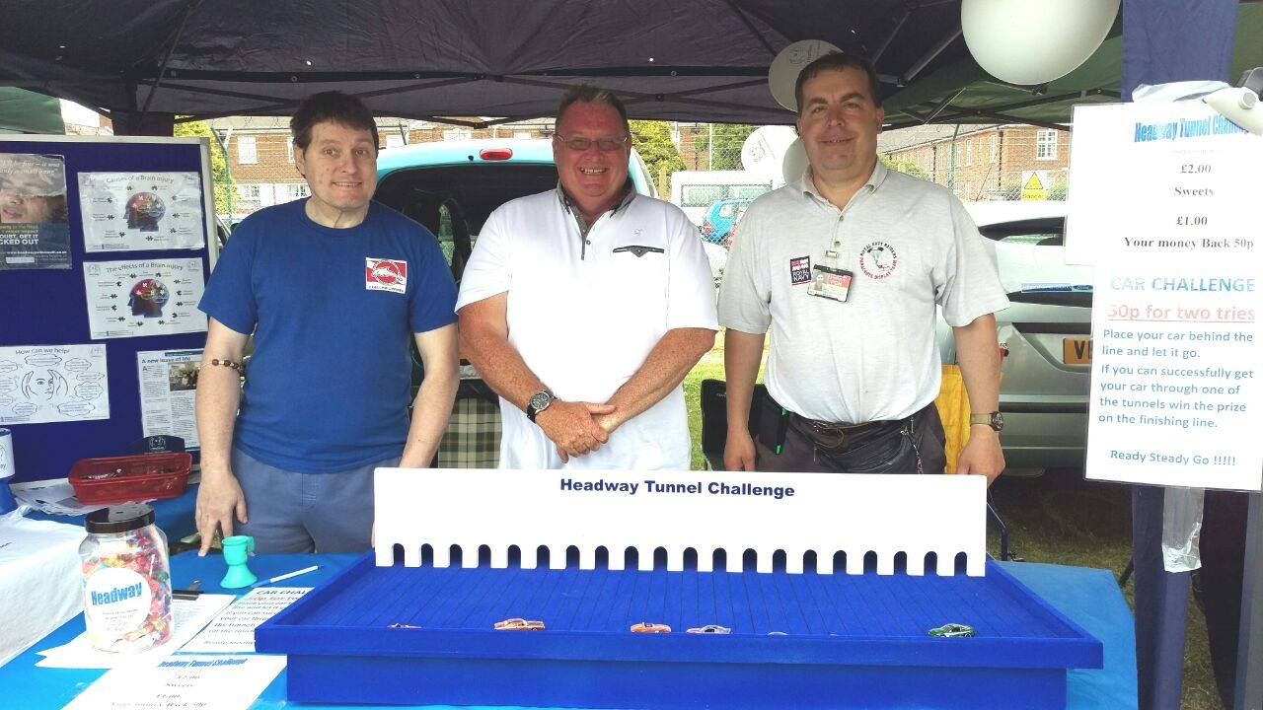

Slide 11
What helps
Brain Injury is a hidden disability
What you see is not necessarily what you get

Slide 12
What helps
Symptoms vary enormously
Even from the same Brain Injury
Depends on age, stage, support………..

Slide 13
What helps
FATIGUE
Headaches physical exhaustion
From doing too much

Slide 15
What helps
Expect Improvement!
Reduce Cognitive deficit by early signposting to Headway

Slide 16
What helps
Slow simple speech
‘But we aren’t stupid’

Slide 17
What helps
Say it and write it
Write down important information, give sheets of instructions, diagrams, video

Slide 18
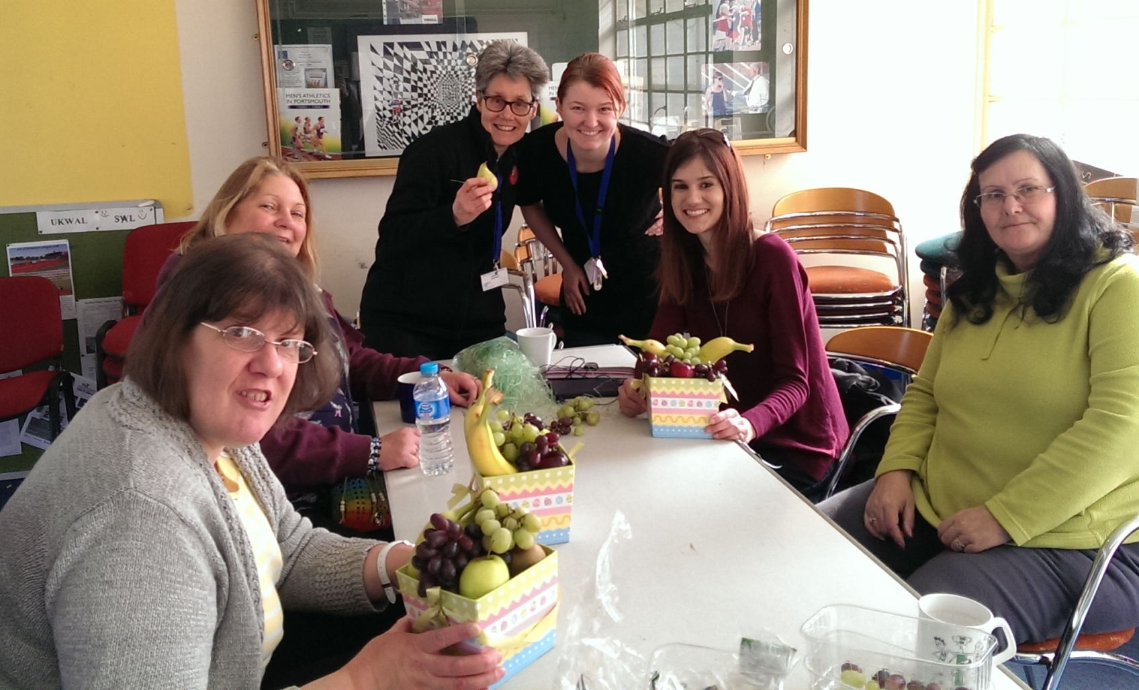

Slide 19
What helps
5 knocks!
Say it, hear it, write it, read it make an association

Slide 20
What helps
3 Slot day
Morning, Afternoon and Evening
Only do one major thing each day

Slide 21
What helps
Good Diet
Water and Oil

Slide 22
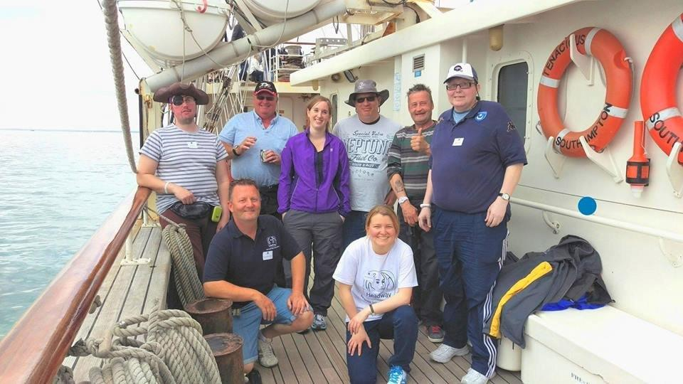

Slide 23
What helps
Don’t give false hope
But never say never!!

Slide 24
Referral Process
Referrals from GPs, Social Workers,
Clinical Nurse Specialists, SLTs, Neuro Psychologists, OTs, Physios and other appropriate professionals. We do accept self-referral with appropriate backing from GP.

Slide 25
3 messages to take away
Early bridging to Headway from Rehab to reduce cognitive deficit
Understanding Brain Injury to build supportive framework
Support for individuals to engage with us and avoid crisis point

Slide 26
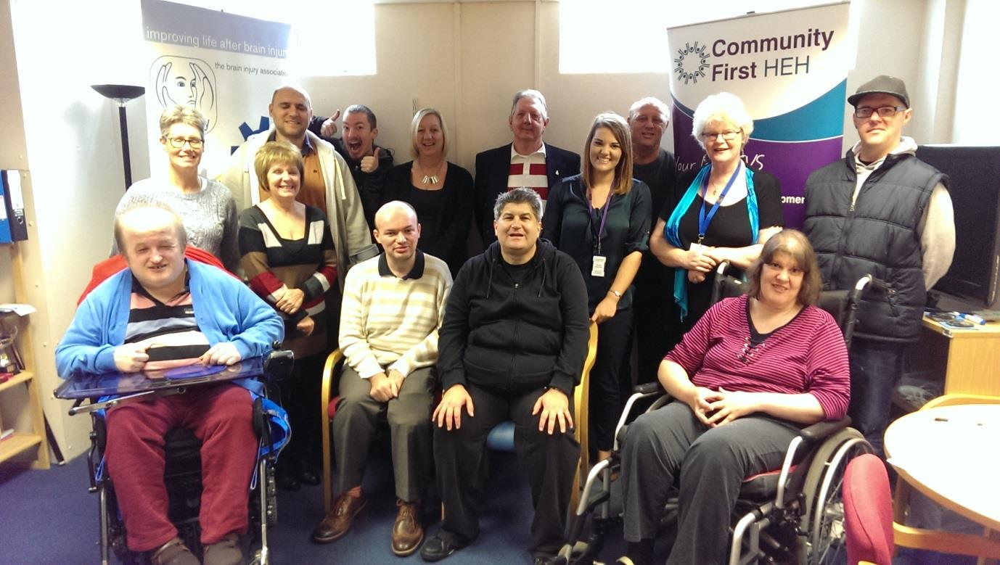

Slide 27
Finding a pathway through services on a journey with Huntington’s Disease
Annette Scivier
Wife, mother and Carer
Notes:
Good morning ,
My story as a carer and wife, this story is retold many times in our communities.
It illustrates the challenges faced by those of working age with HD, before and after diagnosis. It is a genetic disorder passed by autosomal dominance, which means each offspring of an affected parent has a 50;50 chance of also developing the same illness. It causes progressive physical disability, cognitive disability and a range of psychiatric disorders, to different degrees in each individual.
I have mad many friends across Hampshire via the Huntington’s Disease Association with similar stories. We give each other huge understanding and support and direction.
We rely on professionals at crucial stages. There is a real need for partnership working .
These are NOT an illnesses made worse by lifestyle choices , nationality or protected by social class or education. They are becoming more common as we are cured of cancer and cardiovascular disease.
My story is not intended to criticise any individual , but illustrate the systemic challenges which we can work on together during today. I have got to know some great folk along the way.

Slide 28
The start of the journey
Met when I was age 18,Husband was 22, married 5 years later
Told that his father had died, 10 years after his parents divorced, his father had become “depressed” and lived at Knowle Hospital until a sudden death when my husband was 18 , having not seen him for about 9 years.
His father was 49.

Slide 29
The road gets tough…
Age 32 my husband leaves his career and completes an MSc, whilst I get a new job.
He leaves 4 jobs in 4 years (and got a new mortgage during 3rd job)
Our 1st child arrives according to plan -I return to work to pay the bills

Slide 30
…and tougher
Relationship was strained next 2-3years
“normal” tiredness and “male” behaviour around the house – eg multitasking, chores
Washing up skills lacking
Many DIY projects started, not finished
Mood swings evident between jobs
Notes:
SLIDE FIRST
Looking back these were likely symptoms of failing cognition but were misinterpreted by me as normal variation in a stressful life.
We had some good times too , enjoying coastal walks and beaches .
His reasons for the difficulties were repeated, and quite plausible , looking back there was considerable repetition ( or perseveration )

Slide 31
…ups and downs en route
Mood swings became aggressive with suicidal threats
Scary
Attributed to his job not being the right one, difficult commute, or….lack of job
Refused to get help…. his medical record may affect job hunting
Refused to apply for benefits…I had a job
Notes:
Complete lack of insight was apparent as I look back.
Certainly lack of ability to see things from another’s perspective. I have heard HD described by psychiatrists as adult onset autism, if that helps.

Slide 32
The journey continues…
I had by now received counselling from 3 organisations
Our 2nd daughter was born and I returned to work ,my job itself becoming very stressful
Thankfully we left a crumbling cottage at his next job change
Left that job twice, half completing a teacher training course three times, before I Googled our problem…..

Slide 33
Diagnosis by Google….
NOT to be recommended for HD
NOT what my best friend intended when she said I really needed to find out why my husbands behaviour and movements were odd for 10 years
Reading the leaflet “behaviour problems” on HDA charity website it suddenly “clicked” in my head what I had been living with
Notes:
A copy of that Fact Sheet is available from the HDA stand, and on line.

Slide 34
The hurdles of the NHS begin ….
His kind GP accepted my word on the history without his patient attending and phones a neurologist
Seeing the patient helps with diagnosis of movement disorder…not easy if you don’t believe you are ill.
Letters and phone calls from neurology secretary are misunderstood by the patient ( assumed to have intact capacity and organisational skills )
Bike accident needing stitches convinces him and his family that, yes, something is odd about his balance and twitching
Spurious blip on an ECG in casualty convinces my husband that return visits to his GP are needed

Slide 35
Lack of signposts for professionals
My husband managed half a neurology outpatient appointment- long enough to confirm my suspicions
“open appointment” given to return – DNAx2
Established that I had been in touch with HDA –I felt guilty knowing Regional Care Advisor covered 3 counties
No nurse in clinic to ask if I had any questions or needed information
No suggestions to his GP on who was available locally, or elsewhere, with experience of HD
Notes:
SLIDE FIRST
I was unable to persuade him to return to the outpatient department , in spite of heated discussion in the hospital car park .
He told the neurologist that his problems would all improve once we sorted our relationship problems out and he got a job . He didn’t need any genetic tests…
READ NOTES ON NEXT SLIDE, before showing slide

Slide 36
Who does what in a challenging illness ? Who guides the way ?
Regional genetics service
National Research team at Queen Square
Refusals to see adult psychiatrist
Agrees to speech therapist + dietician but not local neurologist or physio
Notes:
READ BEFORE SLIDE
Thankfully the idea of participating in research convinces my husband to travel ( alone ) to a regional genetics service , then London to take part in research.
Positive gene test helps his insight – partially – enough to apply for DLA and his small pension and we begin to come to terms with what must be the worst life limiting illness to affect families
offers of referral to see the local mental health team repeatedly refused- insight is better for physical symptoms than cognitive.
He sees a Speech Therapist and Dietician – keeping enough calories on board made a huge difference to mood and concentration.
SHOW this slide
There was no insight into effect on close family , no ability to see things from another person’s perspective.
Carefully avoids spending time with others outside our immediate family ( me + 2 kids) …self protection or social withdrawal ?
All the professionals I had access to had to respect his choices. As a carer I was frustrated .
Another carer and wife recommends the local memory service as being effective. They visited and supported her affected husband in the next town who was just under 65.
I have to persuade MY GP to refer ME to get a chance to speak to the psychiatrist in the memory service about HIM– neither of us are over 65
I didn’t have much confidence in whether this would work or not. …but HD involves lots of unconventional tactics to survive.
This was 2 years after our neurology diagnosis….I finally get to talk to a local consultant who understands my difficulties.

Slide 37
“Visiting patients with poor insight and who are difficult to engage, is what our team does” …..The Psychiatrist for Elderly had experience of dealing with this condition – why didn’t anyone tell me ?
Notes:
AFTER SLIDE
I nearly hugged the psychiatrist
He understood that repeated refusal to attend appointments and take medication had frustrated my attempts at getting help
Thankfully the National Dementia Strategy had strengthened our local Memory Service at the right time for us ….if only our GPs had known , if only the Clinical Genetics service had known , if only the neurologists had known.
My husband was age 50 yet the skills of managing dementia do help many dealing with HD. If the local contracts allow this.

Slide 38
How do you know what you don’t know ? In spite of a wealth of information , where do you start? Who do you ask?
Professionals consider HD to be rare – yet its twice as common as quoted in text books,
and as there is no cure – yet – what difference does it make? Why should they bother?
Notes:
AFTER SLIDE
Its a challenge in disseminating information about a complex illness with many perspectives
Being variable means no one service takes control – are the physical disabilities predominant or psychological ?
Is it medical ? Or social ?
Which websites do you start with? Which organisations do you approach , when you have the energy ? How do professionals themselves find a pathway. The Speech Therapist who met my husband had asked “ who co-ordinates his care”? ….

Slide 39
The journey gets harder still
As a family we strived to focus on some positive times together
Our understanding of HDs effect on thinking helped us adapt – to a degree , with help from the Memory Service OT
Refused drugs, consistently
Unable to see the effect of his behaviour on us
Rational discussion on some points impossible
Sufferers appear selfish- their personality changes
Notes:
READ AFTER SLIDE
Next 2-3years I hungrily devour anything I can read on HD, attending meetings ( even arranging one for local professionals) , keeping in touch with friends in similar positions
I have fantastic friends in community, my parents ( not getting younger )moved to live to be nearby , and my faith sustains me
Reduced hours of work , in stages , extremely thankful to accommodating colleagues.
Our family outings – although positive – had recurring disaster theme- frequent rescues and challenges as HD progressed , sailing and travelling become stressful and exhausting as the brain tries to cope with planning and sequencing.
My husband loved outdoor adventure and wanted to “make the most of it”
Pushed himself to the limit of endurance by cycling and running “ to fight his illness “ rather than take drugs
Any discussions about making family life easier became circular rows
Any concept of planning or organising was impossible
Increasingly small tasks became more difficult resulting in agitated aggressive outbursts – no recognition of their impact
Not witnessed outside the family- many HD sufferers retain an incredible ability to hold it together for short periods ….eg appointments with doctors and social workers , but they cannot sustain it..at home .
(Discussion of respite caused huge anxiety – worsened the agitation- I think, looking back it seemed a threat that I may leave.)

Slide 40
I could not function-off sick
I left my job
Eldest daughter struggled to study A levels
Youngest daughter “tummy ache” refusing school – worried about daddy, and now mummy
Agitation worsened when I took kids away for 5 days “respite” and continued to worsen- in front of the kids – it was getting scary again
Notes:
Obtaining respite from HD is extremely complicated to negotiate, yet desperately needed for physical and psychological rest. He relied on me to think for him, so I had no break from daily challenging behaviour..

Slide 41
Gaps in services
Neurology or psychiatry
Adult psychiatry or old age psychiatry – depends on area
Young Carers between contracts -6m gap
Emotional support for me ( main carer)-unclear
Carers assessment – 5 phone calls
Websites and services (eg advocacy and mediation) for dementia and mental health do not consider HD to be part of their remit
Mental Health Act or Family Law Act?
NHS England is unsure if neurology services are commissioned locally by CCGs or by national Specialist Commissioning
Notes:
THIS SLIDE SUMMARISES THE MAIN GAPS I ENCOUNTERED(-READ NOTES )
Neurology or psychiatry-who leads?
Adult psychiatry or memory service –depends on the area
Children’s support –gaps between education and health – gaps between contracts for Young Carers support for 6months – didn’t meet criteria for CAMHS- or anything else at the time
Psychologist for me, main carer – could not deal with work related matters – a recurring problem for carers who also need to work
Websites were trawled- time and again HD again fell in Gaps between some major high profile charities. ‘HD was not part of their remit’ and national websites don’t give detail of regional or local services, nor did local hospital websites. HNA have been trying to put that right.
A new social worker visited me after 5 calls to call centre , my husband went jogging to avoid meeting him on 2 occasions.
Domestic violence websites and local refuge team told me of another avenue open to me – but I had to act quickly for the Law to be effective. I took advice from the out of hours Mental Health Team – who confirmed The Mental Health Act was unlikely to help .
I was seriously stressed out, had slept at my parents while youngest was on a school trip , previously this had triggered agitation . At least she wasn’t around to witness it this time. I had to risk leaving my eldest at home studying. They were 10 and 17.
NHS England remains unclear which aspects of care for long term neurological conditions are specialist or locally commissioned. They are crying out for integration and use considerable inpatient and residential care resources.
I first wrote this in November 2013, no improvement in these major commissioning issues to date. I represent HNA at the Wessex SCN for MH,D and N so ask at every opportunity.
To continue my story…

Slide 42
17 year old – now seriously stressed-needed a ‘doctors letter’ for the exam board
Which doctor ? I asked …so teacher asked for a list of those professionals involved
Listed 42 ,all kind, but uncoordinated.
2 months later it had risen to 57 and no better coordinated in spite of my asking informally and formally several key professionals to find a single case manager
Notes:
READ BEFORE SLIDE
For the next couple of months all I did was try and seek help from whoever seemed to be the most appropriate person for that problem.
I was often passed to another professional, “not my remit” or we “didn’t meet the criteria”.

Slide 43
I had to take an Emergency Injunction to protect myself and my children
Several judges and barristers asked why it had come to court, this man was ill
I telephoned 4 residential homes from the court to find one to accept a man that evening for respite care. He was under 65 who could walk and self care but not prepare a meal or manage his affairs, so could not live unsupported.
Notes:
READ FIRST
I represented myself in court to obtain an Emergency injunction to protect myself and my children.
It was only when the barrister in court laid out my stark choice that I realised I had to choose between caring for my children –at the start of what may be a shortened life , and my husband whom I still loved.
I wanted to maintain his quality of life, being his advocate and companion.
Several judges and barristers asked why the courts had to deal with this case….because HIS choices needed to be respected, over mine, even though with his illness he couldn’t see how the kids were impacted.
I telephoned 4 Care Homes from the court to see who had a vacancy that evening.

Slide 44
What else could I have done differently? If you were in my shoes would you have followed a different route?
Notes:
SLIDE FIRST
I am afraid I have become angry at the battles I have had to face , on top of facing a devastating illness, so I have become passionate about trying to improve services for HD….in time for my children. They are at 50/50 risk of inheriting this illness and witness not only their father deteriorating, but my confused battles for solutions .

Slide 45
Finding a pathway through services on a journey with Huntington’s Disease
Dr Annette Scivier
Wife, mother and carer
GP for 20 years
Notes:
Thank you for listening to another harrowing story of Huntington’s Disease – I have spared you much of the difficult detail. The only multi-professional meeting which occurred was a MARAC. I wasn’t invited.
As a health care professional I could find no pathway through the maze of health and social care.
To update you :
I had only hoped for respite for a month ,so my daughter could study for her exams in peace.
My husband was in that respite centre for 11 months, and has adapted surprisingly well to their routine. I provided basic care alongside the staff, I explained and given leaflets on various aspects of care as his condition has changed a lot during that time. I remained his advocate, and now have an LPA in place. Much communication, I was told, was blocked without it. Open, honest communication across organisations with clear leadership may have helped .
For the last 18 months he has been lucky to have a small flat within a “secure” care home which specialises in dementia including challenging behaviour. It is close to the coastal path overlooking Hurst Castle and Hampshire, we can visit easily several times a week to walk and spend time as a family, but not at home.
(Unfortunately I have been advised that it would be confusing and distressing to allow visits home.)
My children and my husband know I am speaking today .Please respect them in using this case to improve your knowledge. I don’t mind answering questions if it helps your understanding to help other families.

Slide 46
Motor Neurone Disease
Louise Rickenbach
Regional Care Development Adviser
Hampshire, Dorset, Isle of Wight and Jersey
Notes:
I am going to talk about the disease, how often you are likely to come across it , the affects on person and their family and what you have to think about when referred a person with MND

Slide 47
I am going to cover...
What is MND, facts and figures, briefly.
What you need to consider in your role.
How the MND Association can help.
With the help of John’s story

Slide 48
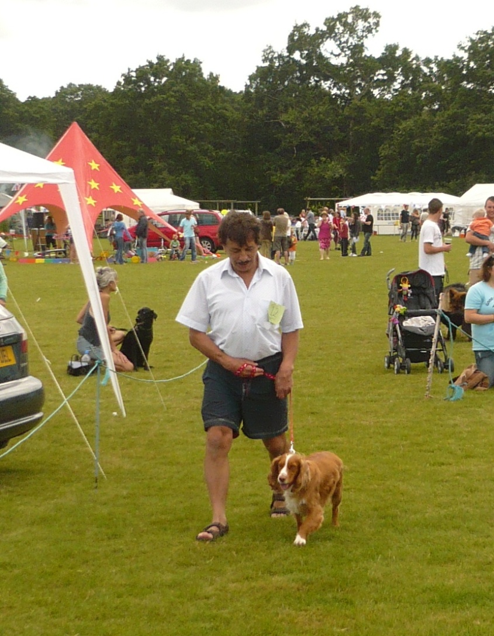
John’s story
With the very generous permission from his family
Think about what your role would be, in his journey with MND
Notes:
I will tell the story of John during this talk.

Slide 49
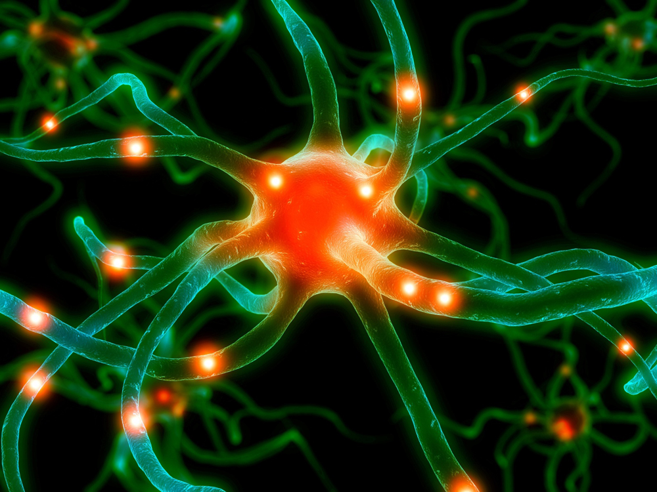
What is MND?
A progressive disease that attacks motor nerve cells in the brain and spinal cord leading to weakening of muscles.
Terminal Disease
Rare
Diagnosis difficult

Slide 50
Motor Neurone Disease
Incidence: 2-3 per 100,000
Prevalence: 5-7 per 100,000 people in UK
MS incidence : 3-4 per 100,000
MS prevalence: 100-150 per 100,000
Notes:
Explain Incidence and prevalence
Note the similarity of Incidence and the difference in prevalence

Slide 51
Hampshire population 1.7 million
Look at your population size
You would expect there to be 80-110 people living with MND in Hampshire.
Perhaps 40 new cases per year

Slide 52
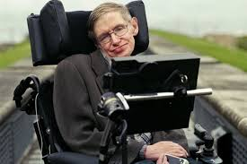
Prognosis
David Niven
Notes:
Has had MND for 50 years? David Niven died three years after being diagnosed

Slide 53
Average survival is about 2-5 years
30% die within one year of diagnosis,
50% within two years
This is relevant to your planning
The most consistent predictor of survival is the rate of progression in the first year
Notes:
1 in 232 died with MND (Office of national statistics 2012)

Slide 54
Motor Neurone Disease types
Prognosis
Amyotrophic lateral Sclerosis (ALS) Most common
Progressive Bulbar Palsy (PBP)
Progressive Muscular Atrophy (PMA)
Primary lateral sclerosis (PLS)
2-5 yrs
About 90%
<2 yrs
5-10yrs
>10 yrs
Notes:
PMA lower M Nerves PLS Upper motor nerves

Slide 55
90% of people have the sporadic form (just occurs, no family history)
Highest incidence 50-70 yrs
50% are under 65
i.e. of working age
Benefits and finances are important
Notes:
My youngest 18 oldest 96!
Age of onset study (beghi et al 2007)

Slide 56
HELP!
Attendance Allowance
Personal Independence Payment
Carers Allowance and assessment
Personal Health Budget
Direct payments
Access to
Work scheme
Employment Support Allowance
Continuing Healthcare

Slide 57
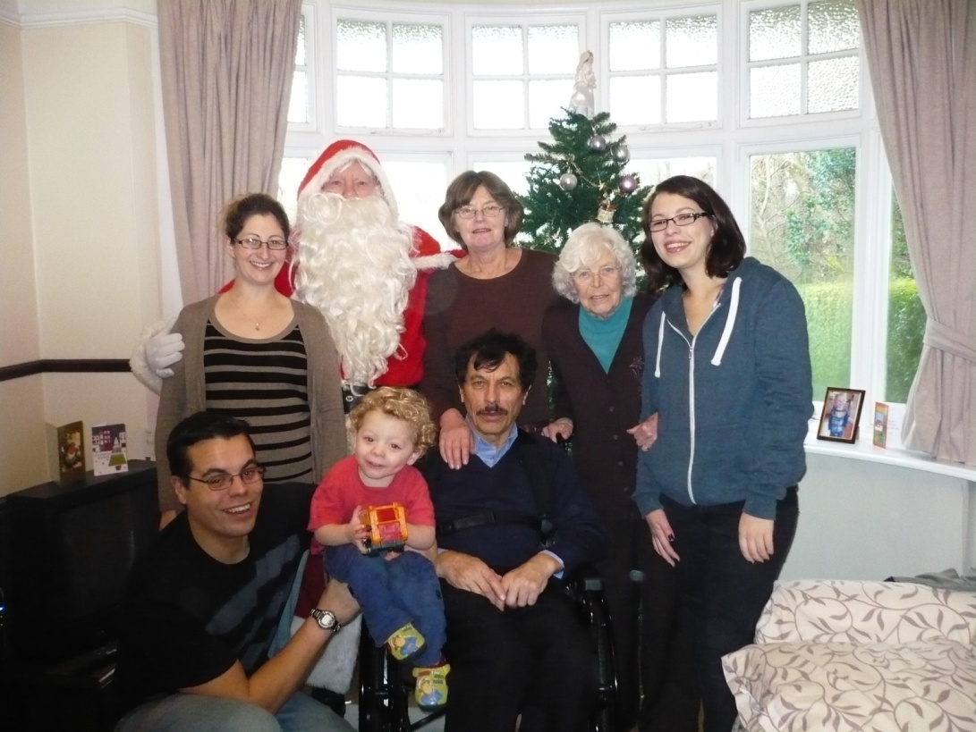
John’s story
Previously fit, 67 yrs old
Very happily Married with four children
Had recently retired as a postman
Owned their chalet bungalow
His wife had back problems
Determined
character

Slide 58
John’s story
Stumbled on the stairs and fell in the kitchen.
Attended A&E as thought to be a stroke.
Easter
2012
July
2012
Increasing leg weakness and referred to neurologist by GP.
“I was asked to come in for his appointment with the Dr’s. I realised that it was serious”
(Wife)
September
2012
Diagnosed with MND following investigations
Dates are approximate

Slide 59
Some of the Signs &Symptoms
Muscle wasting and weakness
Fasciculation (twitching)
Cramps
Spasticity (stiffness)
Respiratory problems
Speech and swallowing problems
Saliva and mucus problems
Weight loss

Slide 60
Some of the Signs &Symptoms
Fatigue
Pain
Emotional Lability
Fronto- temporal dementia
Cognitive changes

Slide 61
Sunny visit to the Isle of Wight after the diagnosis
John’s story
For his family, the diagnosis was a huge shock. His wife said that they were not aware at all of what lay ahead and tried to cope by themselves, solving problems and borrowing equipment from friends.
“I wish we had asked for more help”
“We tried to keep things as normal as possible”
The family searched the internet for any possible treatment
Put in touch with the MND Association

Slide 62
John’s story
Xmas
2012
John was finding the stairs difficult and they made a decision to make a bedroom downstairs. OT’s looked at adaptations and equipment in existing bathroom.
Stair lifts
Funding routes.
MNDA grants.
DFG’s
planning delays.
Spring 2012
John’s wife was finding it very difficult to do all of John’s personal care and pushing the wheelchair had aggravated her own problem.
Son built a ramp
Easter
2012
Frequent falls meant that his wife did not feel she could keep John safe.
Social worker and District nurse now actively involved
Family sourced a WAV
”
Notes:
Think about adaptations early. Stairlifts an option.

Slide 63
What can Adult Services do to improve quality of life for people affected by MND?
Understanding about the illness and it’s affects and challenges for the whole family.
Holistic, sensitive assessment of the person and carers’ needs.
Anticipatory and pro active planning
No closure of case (or allow very easy re-referring)
One allocated key worker or team
Liaise and communicate with local health and voluntary services

Slide 64
Some quotes...
“Prompt and timely intervention to prevent playing continual catch up, triage through the waiting lists and get out there.”
“Re equipment: it is often difficult to advise about what is going to be needed but people and families are reluctant to accept the concept and need time. Remember what the MNDA can provide in some cases.”
“Be realistic with the person with MND and their family about timescales, disruption etc. with regard to DFGs and any building work.”
“It is important to be aware of each others in-put so that there is a consistent and timely delivery of service.”

Slide 66
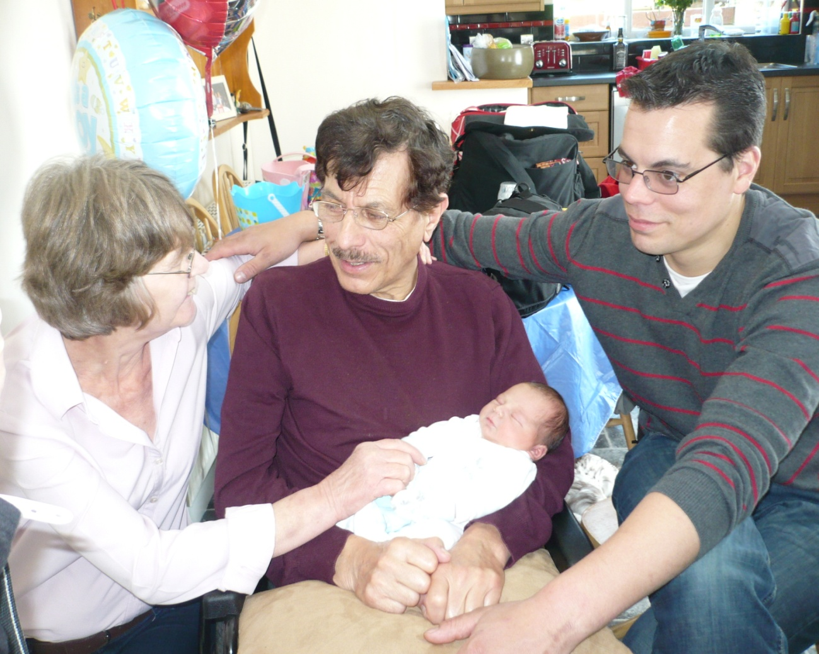
John’s story
Life goes on for John’s family

Slide 67
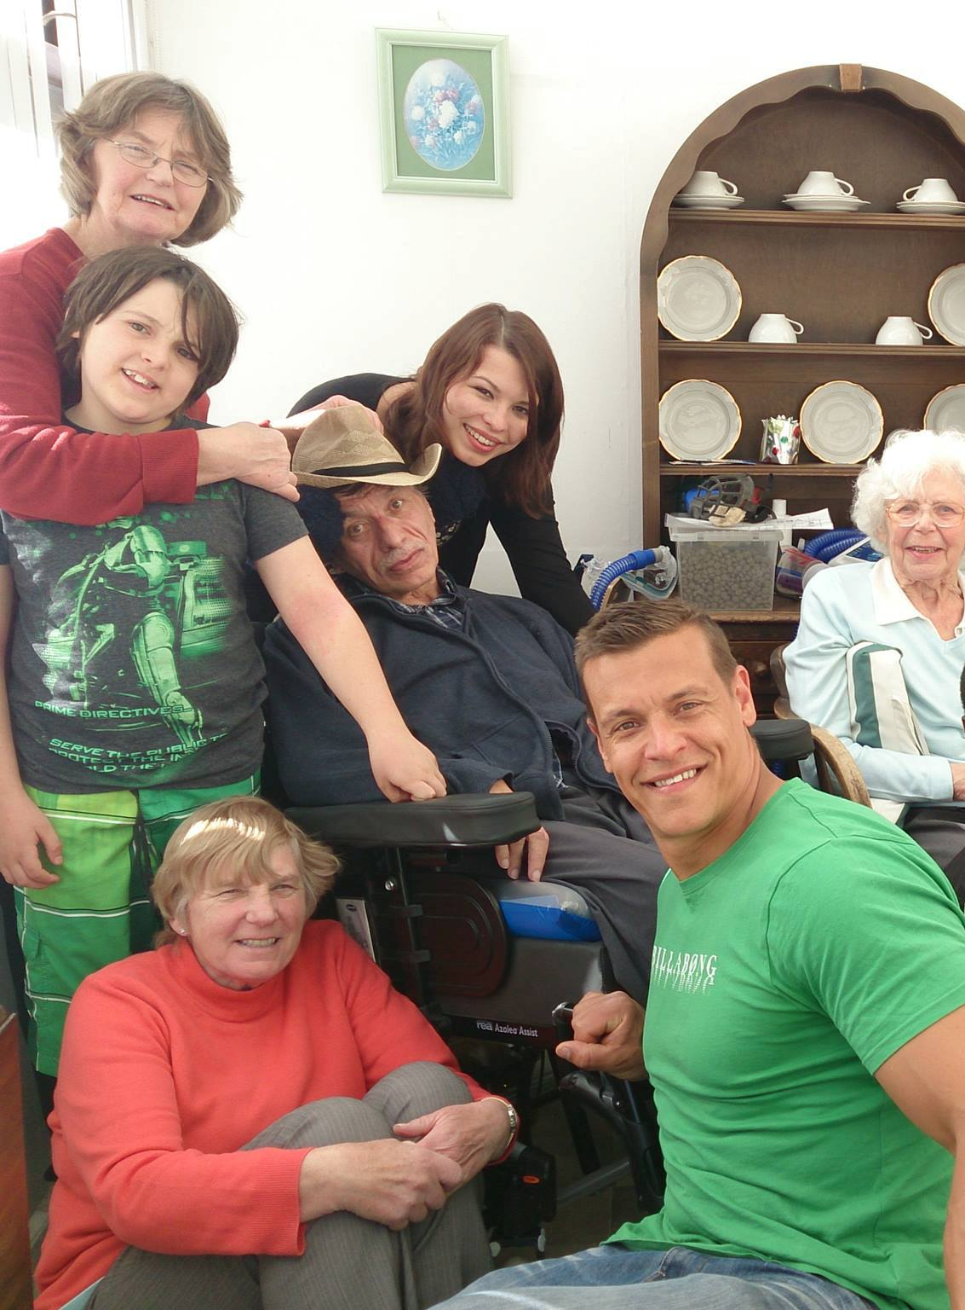
But... It was becoming increasingly difficult to care for him.
CHC funding is often difficult to get.
Xmas 2013 Continuing Healthcare funding for a 24hr carer made it possible for John to stay at home.
This was very important.

Slide 68
John’s story
July 13 John needed a feeding tube (RIG)
and Non-invasive Ventilation initially just for night use but increasing to 24 hours. He used an eye tracking communication device.
Dec 13 He had numerous admissions to hospital with chest infections. Palliative Care services now involved and he wanted to access all possible treatment to extend his life.

Slide 69
Summer14 John found it increasingly difficult to communicate and his family and carer managed to understand his eye slight movements.
Autumn 14 The disease progressed and John was unable to move, was reliant on the NIV, and was spending more time asleep. It was very distressing for his family, who tried to make life as comfortable as they could for him.
John became more sleepy and passed away peacefully in his own bed.
His family are still hugely affected...

Slide 70
How the MND Association can help
Support Groups, open meetings for people with MND and their carers, organised by branches and groups. (Portsmouth, Southampton & Basingstoke)
Association Visitors
Regional Care Development Advisers can provide advice and information
Helpline (MND Connect), Website and publications.
Forums. www.proforum.mndassociation.org and www.forum.mndassociation.org
Equipment loan and financial support services (where statutory services don’t fund, e.g. Stair lift, riser-recliner chairs)
Quality of Life grants

Slide 71
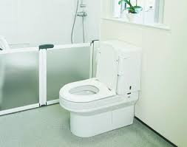
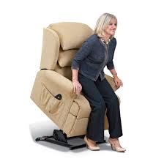
Support |Grants and equipment loan
Form is on the website
www.mndassociation.org

Slide 72
Thank you
Louise.rickenbach@mndassociation.org
03453 751831
MND Connect
03457 626262
Support.services@mndassociation .org
01604 611802

Slide 73
Collaborative Working
Dennis Morgan
Regional External Relations Officer - MS Society
Claire Kinnersley
Senior Practitioner and MS Lead OT HCC

Slide 74
Background
MS is the most prevalent Neurological condition in the UK for young adults affecting over 100,000 in UK; 2165 in Hampshire (excluding Southampton and Portsmouth).
People affected by MS in Hampshire highlighted poor access to services during a survey carried out by the MS Society in 2005.
MS Society made Hampshire a priority area for Service Development.
Engaged with OT Professional Lead for HCC to highlight the benefits of the MS Specialist role.
Provided Impact Study carried out by Reading University provided the evidence required to secure the commitment from HCC.

Slide 75
Background
Three permanent full time MS Specialist OT’s appointed by HCC.
50% funding by MS Society for first 3 years.
100% support from County Council’s - MS Society involved at every stage of appointment.
Excellent Partnership Working developed as a result of the strong relationship.

Slide 76
Collaborative Working
3 Local Steering Groups set up to support the MS Specialist OT service development across the County.
Representation from: MS Nurses, MS OT’s, OT Managers, MS Branch Support Officers, Service Users with MS Society chairing.
Improved communication and good joint working between health, social services and the voluntary sector.
Provided a focus for high quality service development and delivery.

Slide 77
Progress
Services improved rapidly when Specialist OT’s came into post.
Undertaking individualised holistic assessments, care plans and reviews.
Positive feedback from people affected by MS to Health and Social Care Professionals and the MS Society.

Slide 78
User Feedback
' I have needed a lot of support with my husband who has many cognitive problems associated with his MS - the OT has been there for me and totally understanding about MS'
' I have had a variety of health problems including MS - the OT has been able to guide and support me to be independent and have a better quality of life'
' I would like to say how impressed I am with the knowledge on MS from my MS O.T. It is so important that there is a specialist in the community of this subject. We are all different and have different needs and without their help we would be in a very sorry state. My O.T. helps me each stage of the disease progress. She allows me time to heal mentally at each stage before giving me advice with my physical needs '

Slide 79
Developments
Team of 6 Link OT’s with a special interest in MS created across Hampshire to ensure no post code lottery.
Specialist OT’s provide co-ordinating and supporting role to the Link OT’s with quarterly meetings to cascade information, provide training, support and expertise.
Sharing expert knowledge with other social care and health colleagues
Central place for storing and sharing of information shared site on HCC server.

Slide 80
Outcomes
Improved health and well being for people with MS. Timely assessment and intervention which aims to reduces the impact of the disease and prevents further deterioration
MS Specialist OT’s working collaboratively with Health, the MS Society to educate people affected by MS on symptom management (e.g. fatigue) and signposting/referring to other services.
Facilitating support and education in self management skills for people affected by MS

Slide 81
Other Improvements
Improve quality of life. Facilitate support and educate on positive risk taking, using expert knowledge to ensure assessments take into account the fluctuations and unpredictability of MS
Freedom from discrimination and harassment; Training for social care employees and care agency staff
Maintaining dignity and respect; using specialist knowledge and understanding of the person affected by MS to implement timely interventions to prevent safeguarding issues arising
Economic wellbeing; Reduce ‘revolving door’ syndrome for people with MS by offering continuity of care

Slide 82
Achievements
Over 100 plus Care Agency Staff Trained.
Supported and educated OT’s and Social Workers about MS.
Joint working with health and Social Care colleagues on complex cases.
Professionals Study Day
Supporting people with MS and their families to maintain independence (management of the condition / adaptations to environment) delays the need for large care packages.

Slide 83
Rationale for extending collaborative working with other neurological organisations
ADULT SERVICES
Increased demands for services
Limited Resources
Financial Challenges
Integration with Health
Improved Services
Services more joined up
VOLUNTARY SECTOR
Working with the Voluntary Sector on other neuro conditions to ensure that Adult Services access additional skills and resources available.

Slide 84
Summary of Report from the Neurological Alliance (September 2014) Is Localism working For People with Neurological Conditions?
Neurological conditions have been poorly prioritised historically in the health and social care systems.
Neurological conditions are unique compared to other Long Term conditions, they are often not preventable, fluctuate considerably, can deteriorate rapidly and last a lifetime.
Many of the challenges faced by people with neurological conditions in relation to health and social care are similar.
Collaborative working across Neuro conditions was found to have a positive impact on services.

Slide 85
Developing a framework for working collaboratively with other neurological conditions
Updating skills, developing knowledge and competencies of a wider cross section of staff.
Working with the resources in your specific locality.
Coaching/Mentoring (MS Leads upskilling/joint working with colleagues)
Training (Work Force Development) Neuro Conditions.
PD Meeting (3 x a year) for OT’s, Social Workers, Health and Voluntary Sector Representatives.

Slide 86
ANY QUESTIONS

Slide 87
Light Lunch & Networking Opportunity

Slide 88
Workshop one
Social Care Perspective: Reablement & Long Term Neurological Conditions Main Hall
Health perspective: Rehabilitation in the Community White Room
Maximising Independence & Quality at End of Life Yellow Room
Maximising Independence & Early Intervention for the Newly Diagnosed Green Room
There is a floorplan on the reverse of your programme

Slide 89
A new Social Care Perspective
Reablement and long term conditions

Slide 90
Claire Kinnersley (senior Practitioner OT, MS Lead, North Hants)
Michelle Logan (Acting OT Team Manager, New Forest)

Slide 91
Aims of session
To provide an overview of MS, MND and Parkinson’s Disease
To Explore reablement in the management of long term, progressive neurological conditions.
To define our role within reablement
To promote importance of collaborative working

Slide 92
MULTIPLE SCLEROSIS
Disease affecting the Central Nervous System (Brain & Spinal Cord.
Myelin surrounds the nerve fibre (CNS) which helps messages travel quickly from the brain to the rest of the body.
In MS the immune system attacks the myelin so messages are disrupted.
Causes is unknown (a number of possible factors)
Average age of onset 34 years.

Slide 93
MOTOR NEURONE DISEASE
MND is a progressive disease that attacks the motor neurones, or nerves, in the brain and spinal cord.
Messages gradually stop reaching the muscles, which leads to weakness and wasting.
Cause is unknown.
Symptoms are managed to help achieve the best quality of life.
Average age of onset – 43 to 52 years.

Slide 94
Parkinson’s Disease
Caused by a loss of nerve cells in the Substantia Nigra, leading to reduction in levels of the chemical Dopamine.
Dopamine plays a vital role of regulating movement
Cause is unknown
Average age of onset 62 years.

Slide 95
MS, MND & Parkinson’s
What are the main symptoms of each condition and what impact can they have on a person?

Slide 96
Fatigue
It is more than just feeling tired. – invisible symptom – overwhelming tiredness.
Appears suddenly and out of all proportion to any activities undertaken.
Primary fatigue – due to direct result of damage to the central nervous system.
Secondary fatigue – experienced as a result of other factors: i.e. Medication, infection, depression, sleep disturbance
Management of fatigue: pacing, rests, prioritise activities, plan ahead, posture management.

Slide 97
Spasms & Muscle Weakness
Normal muscle tone: Allows us to move, overcome gravity and allows full range of movement.
Two type of tone:
Hypotonia – low tone – joints are unstable and therefore require supporting to be moved.
Hypertonia – high tone joints are very stiff.
Common features of Spasticity
Extensor and flexor spams (sudden movement)
Clonus (shaking)

Slide 98
What is posture?
Posture is simply the positon our body adopts in response to the effect of gravity (in sitting, standing and lying down).
No single posture allows us to carry out everything we want to do and we adapt many different postures in order to do different tasks.
‘Good’ posture allows us to move in the way we want, causing our bodies the least amount of strain and damage.

Slide 99
IMPACT OF BAD POSTURE
Reduced function
Muscle shortening
Increased spasms and spasticity
Increased ataxia
Pain
Pressure sores
Loss of Balance
Swallowing, talking and breathing difficulties
Problems keeping head upright

Slide 100
Speech and Swallowing
Communication: Articulating (slurred/slow/quiet speech) and processing information (word finding). Changes in non verbal communication.
Swallowing: Difficulties with eating and drinking– resulting in coughing and choking
Referral to Speech and Language Therapist.
Advice on:
Communication aids, concentration/remove distractions, food consistencies/peg feed, time, environment, posture and fatigue.

Slide 101
Reablement for long term progressive conditions

Slide 102
What does Reablement mean to you?

Slide 103
Reablement is about…..
Maximising independence
Establishing what is important to the individual
Setting personal goals/plans
Using equipment/adaptations/techniques as required
Programme of targeted intervention where appropriate
Coordinating a collaborative approach

Slide 104
Health
Voluntary sector
CRT
Housing
Person
OT
Family
Social worker
Physio
Sensory
services

Slide 105
What is your role within Reablement?
What are the benefits of a collaborative approach?

Slide 106
What do you need to develop a reablement/collaborative approach, to work with people affected by a long term neurological condition?

Slide 107
Any questions?
Thank you for your time ☺

Slide 108
Break & Networking Opportunity

Slide 109
Workshop Two
Social Care Perspective: Reablement & Long Term Neurological Conditions Main Hall
Health perspective: Rehabilitation in the Community White Room
Maximising Independence & Quality at End of Life Yellow Room
Maximising Independence & Early Intervention for the Newly Diagnosed Green Room
There is a floorplan on the reverse of your programme

Slide 110
A new Social Care Perspective
Reablement and long term conditions

Slide 111
Claire Kinnersley (senior Practitioner OT, MS Lead, North Hants)
Michelle Logan (Acting OT Team Manager, New Forest)

Slide 112
Aims of session
To provide an overview of MS, MND and Parkinson’s Disease
To Explore reablement in the management of long term, progressive neurological conditions.
To define our role within reablement
To promote importance of collaborative working

Slide 113
MULTIPLE SCLEROSIS
Disease affecting the Central Nervous System (Brain & Spinal Cord.
Myelin surrounds the nerve fibre (CNS) which helps messages travel quickly from the brain to the rest of the body.
In MS the immune system attacks the myelin so messages are disrupted.
Causes is unknown (a number of possible factors)
Average age of onset 34 years.

Slide 114
MOTOR NEURONE DISEASE
MND is a progressive disease that attacks the motor neurones, or nerves, in the brain and spinal cord.
Messages gradually stop reaching the muscles, which leads to weakness and wasting.
Cause is unknown.
Symptoms are managed to help achieve the best quality of life.
Average age of onset – 43 to 52 years.

Slide 115
Parkinson’s Disease
Caused by a loss of nerve cells in the Substantia Nigra, leading to reduction in levels of the chemical Dopamine.
Dopamine plays a vital role of regulating movement
Cause is unknown
Average age of onset 62 years.

Slide 116
MS, MND & Parkinson’s
What are the main symptoms of each condition and what impact can they have on a person?

Slide 117
Fatigue
It is more than just feeling tired. – invisible symptom – overwhelming tiredness.
Appears suddenly and out of all proportion to any activities undertaken.
Primary fatigue – due to direct result of damage to the central nervous system.
Secondary fatigue – experienced as a result of other factors: i.e. Medication, infection, depression, sleep disturbance
Management of fatigue: pacing, rests, prioritise activities, plan ahead, posture management.

Slide 118
Spasms & Muscle Weakness
Normal muscle tone: Allows us to move, overcome gravity and allows full range of movement.
Two type of tone:
Hypotonia – low tone – joints are unstable and therefore require supporting to be moved.
Hypertonia – high tone joints are very stiff.
Common features of Spasticity
Extensor and flexor spams (sudden movement)
Clonus (shaking)

Slide 119
What is posture?
Posture is simply the positon our body adopts in response to the effect of gravity (in sitting, standing and lying down).
No single posture allows us to carry out everything we want to do and we adapt many different postures in order to do different tasks.
‘Good’ posture allows us to move in the way we want, causing our bodies the least amount of strain and damage.

Slide 120
IMPACT OF BAD POSTURE
Reduced function
Muscle shortening
Increased spasms and spasticity
Increased ataxia
Pain
Pressure sores
Loss of Balance
Swallowing, talking and breathing difficulties
Problems keeping head upright

Slide 121
Speech and Swallowing
Communication: Articulating (slurred/slow/quiet speech) and processing information (word finding). Changes in non verbal communication.
Swallowing: Difficulties with eating and drinking– resulting in coughing and choking
Referral to Speech and Language Therapist.
Advice on:
Communication aids, concentration/remove distractions, food consistencies/peg feed, time, environment, posture and fatigue.

Slide 122
Reablement for long term progressive conditions

Slide 123
What does Reablement mean to you?

Slide 124
Reablement is about…..
Maximising independence
Establishing what is important to the individual
Setting personal goals/plans
Using equipment/adaptations/techniques as required
Programme of targeted intervention where appropriate
Coordinating a collaborative approach

Slide 125
Health
Voluntary sector
CRT
Housing
Person
OT
Family
Social worker
Physio
Sensory
services

Slide 126
What is your role within Reablement?
What are the benefits of a collaborative approach?

Slide 127
What do you need to develop a reablement/collaborative approach, to work with people affected by a long term neurological condition?

Slide 128
Any questions?
Thank you for your time ☺

Slide 129
Plenary
Hampshire Neurological Alliance

Slide 130
‘Reablement is everybody’s business’
Hampshire Neurological Alliance Study Day
in collaboration with Hampshire County Council

